Slide 1
Kindergarten Math Do Nows
May 4 - 8, 2020

Slide 2
Monday’s Do Now
Match the missing number to make 10.

Slide 3
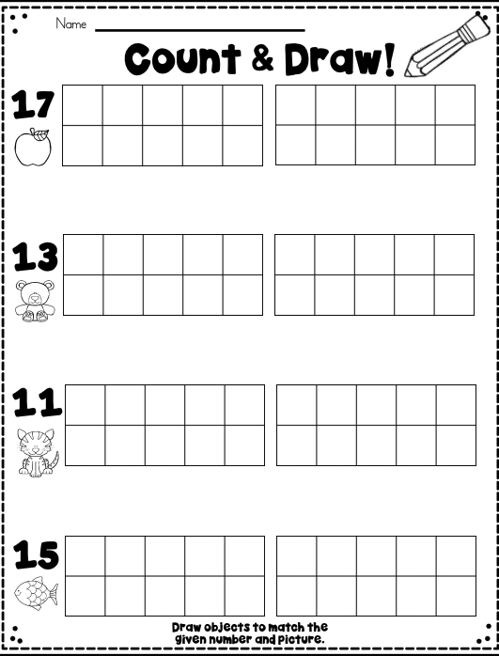
Tuesday’s Do Now

Slide 4
Wednesday’s Do Now
Count and write how many.
Now compare the numbers.
Which one is greater - the bears or the smiley faces?
How do you know?

Slide 5
Thursday’s Do Now
Count and write how many.
Now compare the numbers.
Which one has less - the butterflies or the cherries?
How do you know?

Slide 6
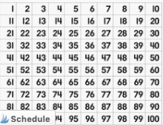
Friday’s Do Nows
Using the 100’s chart above:
what number is 10 more than 20?
10 more than 30? 10 more than 40?
What pattern do you see?

